Slide 1
Chest X-ray Image Classification in Disease Detection
- PAWAN MORE

Slide 2
Introduction :-
Chest diseases are very serious health problems in the life of people. These diseases include pneumonia, asthma, tuberculosis, and lung diseases. The timely infectious diseases have had civilization-altering consequences. so, diagnosis of chest diseases in the early stage is very important.
In this study, I have considered 3 diseases Pneumonia, COVID-19, and Tuberculosis (TB) these diseases can be easily identified using chest X-rays and CT scans.

Slide 3
Problem Statement :-
The primary goal of this project is to design, train, and evaluate a deep learning model that can accurately classify chest X-ray images into one of the following categories: 'Pneumonia,' 'TB,' 'COVID-19,' or 'Normal' (for non-infected cases).

Slide 4
Objectives :-
To design and implement deep learning models for multi-class classification of chest X-ray images.
To evaluate model performance in terms of testing accuracy.
To tune the model with hyper parameter tuning.

Slide 5
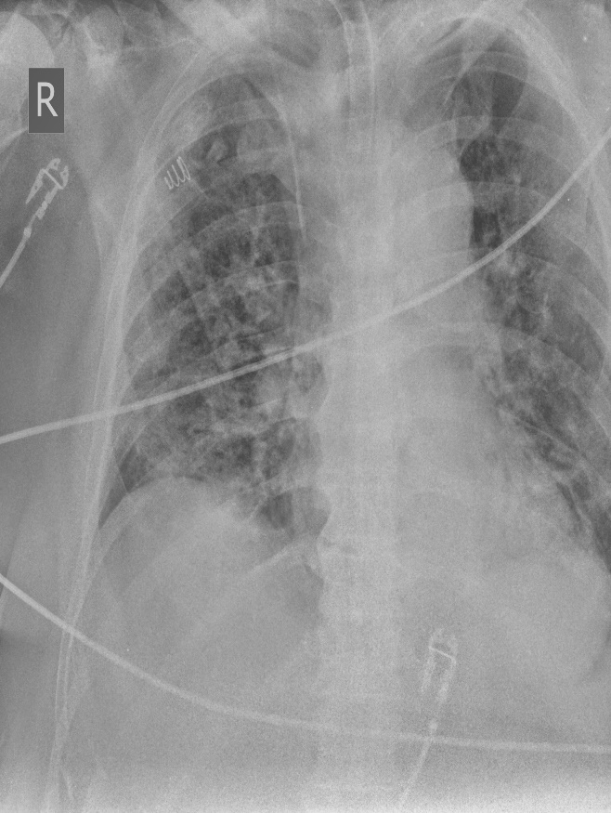
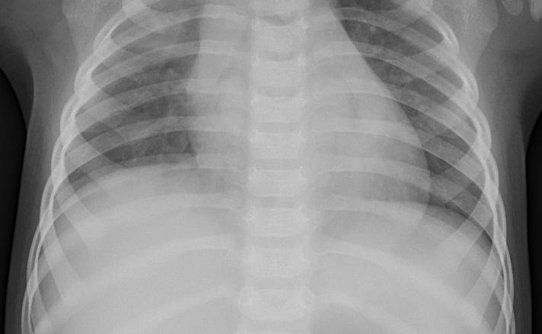
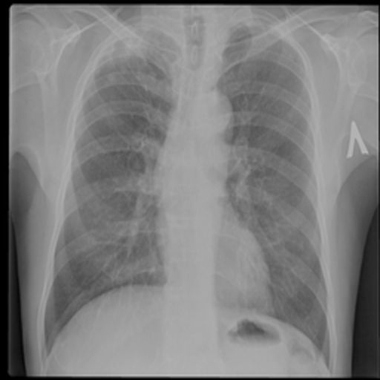
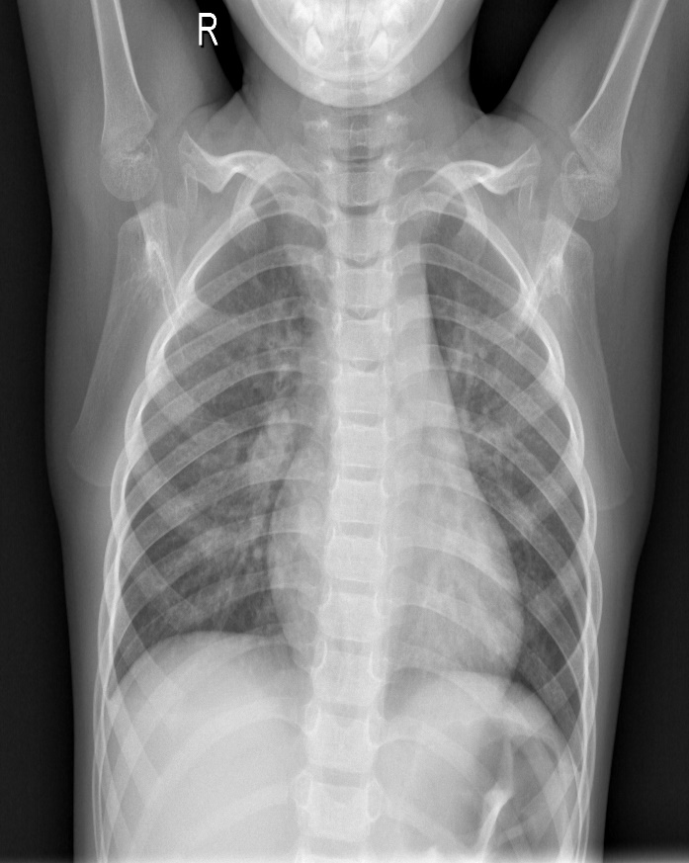
Input Data :-
Covid-19 Pneumonia TB Normal

Slide 6
Model Architecture :-
Layers | Filters | Filter size | Activation
Convolutional layer | 128 | (3,3) | Relu
Convolutional layer | 128 | (3,3) | Relu
Batch Normalization layer
Max pooling layer
Convolutional layer | 256 | (3,3) | Relu
Convolutional layer | 256 | (3,3) | Relu
Batch Normalization layer
Max pooling layer
Convolutional layer | 512 | (3,3) | Relu
Convolutional layer | 512 | (3,3) | Relu
Convolutional layer | 512 | (3,3) | Relu
Batch Normalization layer
Max pooling layer
Flatten layer
 | Neurons
Fully connected Dense layer-1 | 128 |  | Relu
Fully connected Dense layer-2 | 128 |  | Relu
Output layer | 4 |  | Softmax

Slide 7
0.001,
0.001,
Parameters :-
Optimizer = Adam
Learning rate = 0.001
Loss = sparse_categorical_crossentropy
Metrics = accuracy
Epochs = 1000 (with using early stopping)

Slide 8
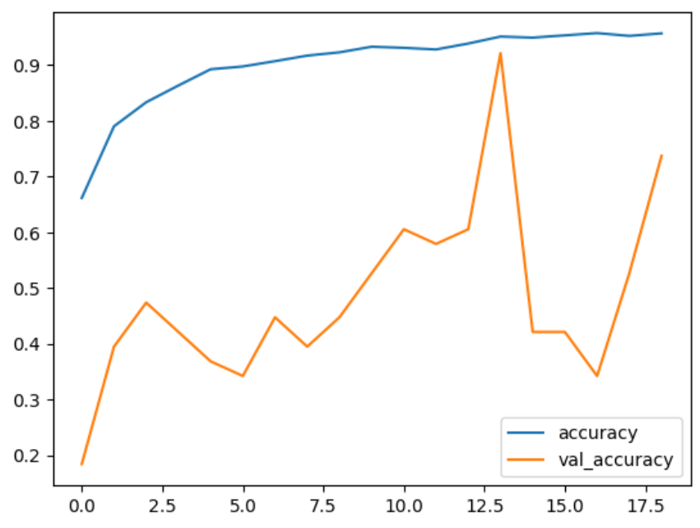
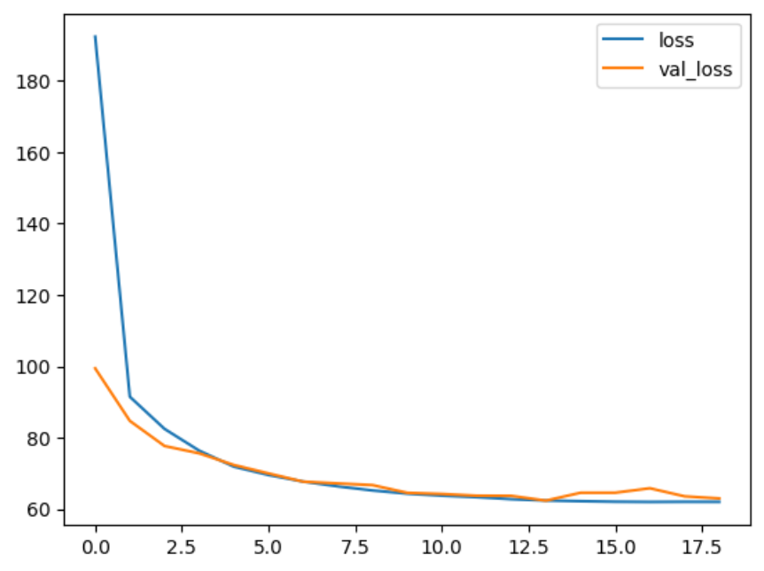
Accuracy and loss with first model :-

Slide 9
Hyperparameter tuning with keras tuner
Model Architecture :-
Layers | Filters | Filter size | Activation
Convolutional layer | 64 | (3,3) | Relu
Convolutional layer | 64 | (3,3) | Relu
BatchNormalization
Max pooling layer
Convolutional layer | 64 | (3,3) | Relu
Convolutional layer | 64 | (3,3) | Relu
BatchNormalization
Max pooling layer
Flatten layer
 | Neurons
Fully connected Dense layer-1 | 80 |  | Relu
Fully connected Dense layer-2 | 80 |  | Relu
Dropout layer
Output layer | 4 |  | Softmax
Parameters :-
Optimizer = nAdam
Loss = sparse_categorical_crossentropy
Metrics = accuracy
Epochs = 1000 (with using early stopping)

Slide 10
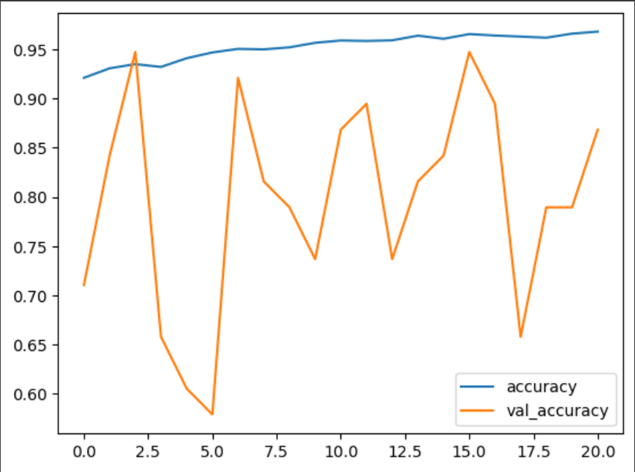
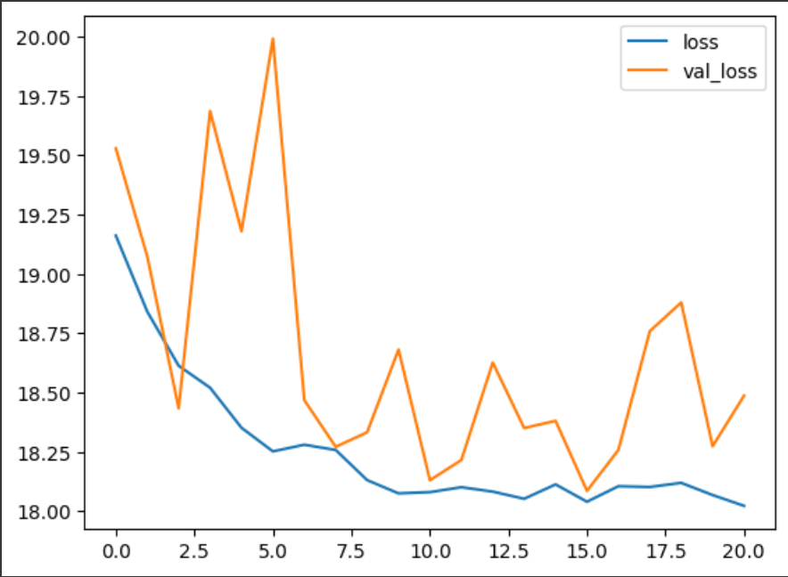
Accuracy and loss with tuned model :-

Slide 11
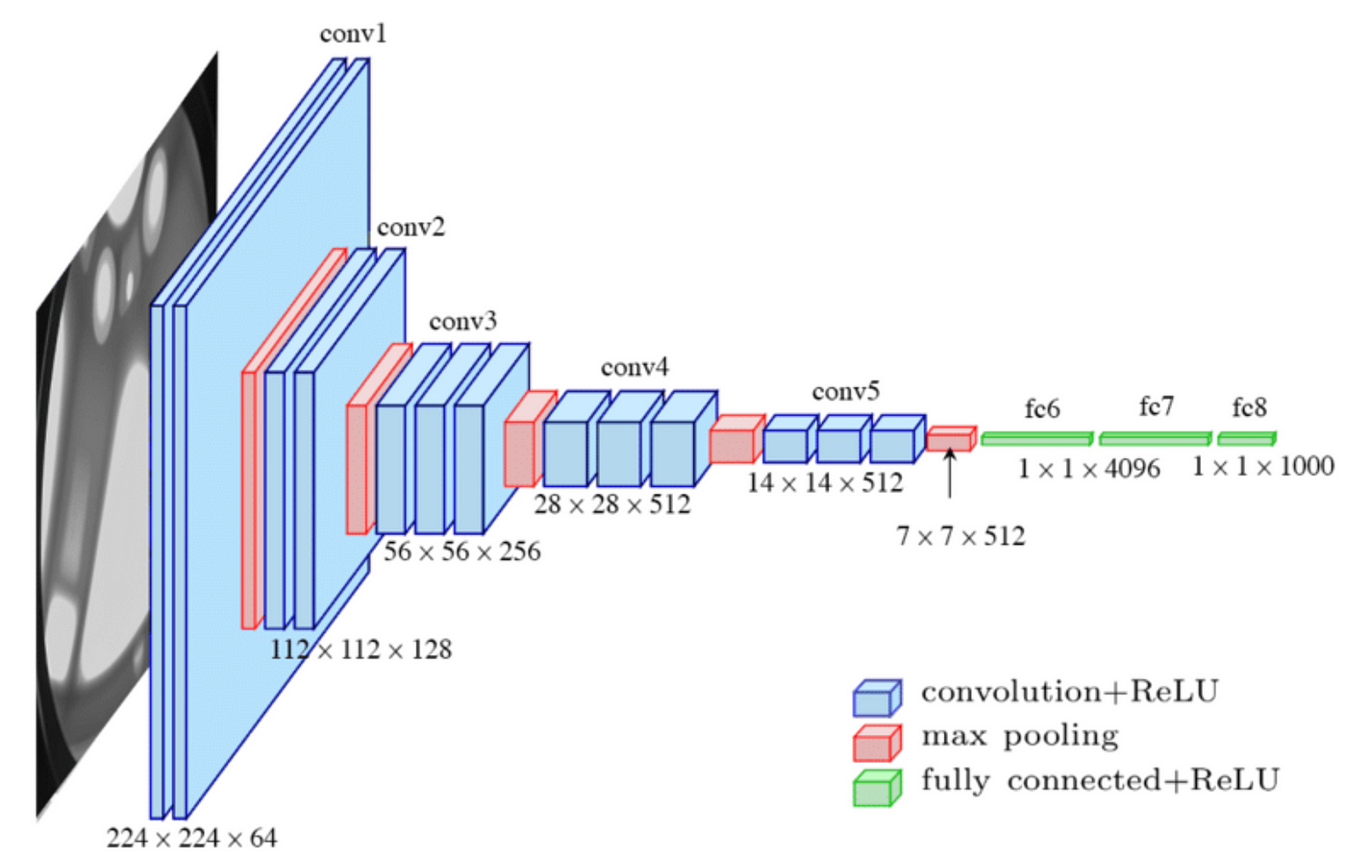
VGG16 Model Architecture:-

Slide 12
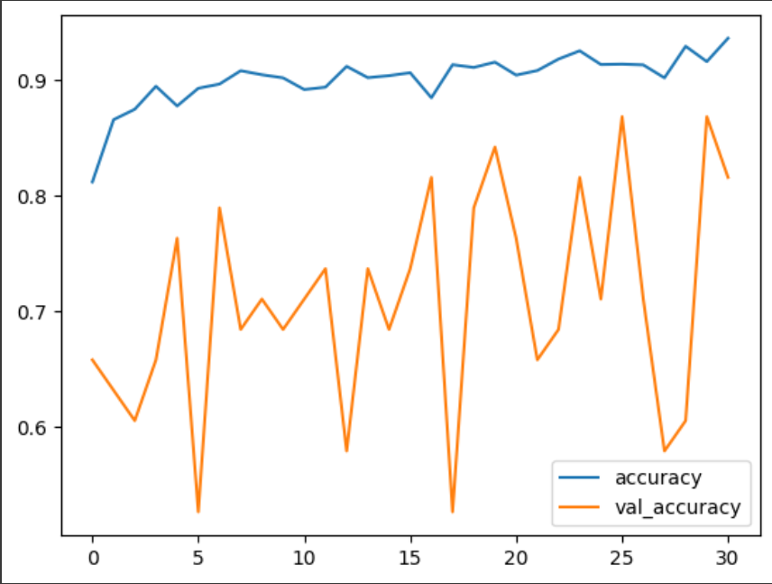
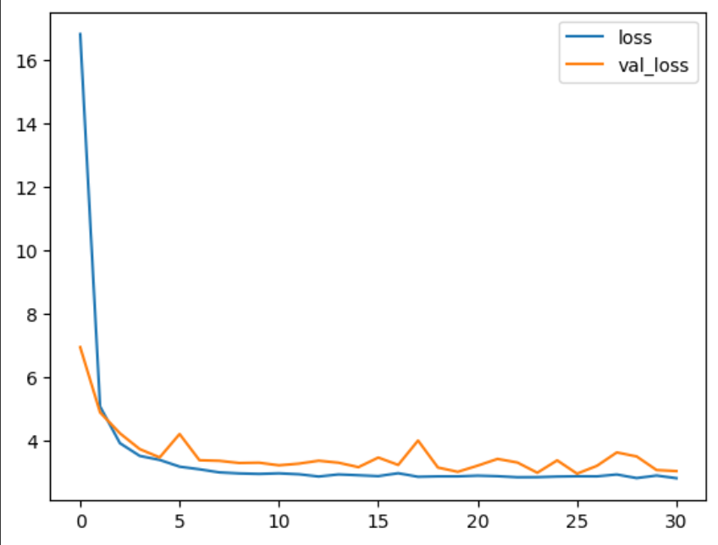
Accuracy and loss with VGG16 model :-

Slide 13
EVALUATION MATRIX TABLE :-
Models | Accuracy
Model 1 | 92.11%
Model 1 (Tuned with keras tuner) | 94.74%
VGG16 model | 86.84%

Slide 14
Conclusion :-
In this project, I developed and fine-tuned Convolutional Neural Network (CNN) models to solve a problem classification of chest X-ray images .Initial model achieved an accuracy of 92.11%, and through meticulous hyperparameter tuning, I boosted the accuracy to 94.74%. The comparative analysis also showed that custom-tuned Model 1 outperformed the VGG16 architecture.

